Slide 1
What is Design?
The word “design” is often used as a generic term that refers to anything that was made by a conscious human effort.
Design is also a process that is used to systematically solve problems.
(1) www.ecybermission.com

Slide 2
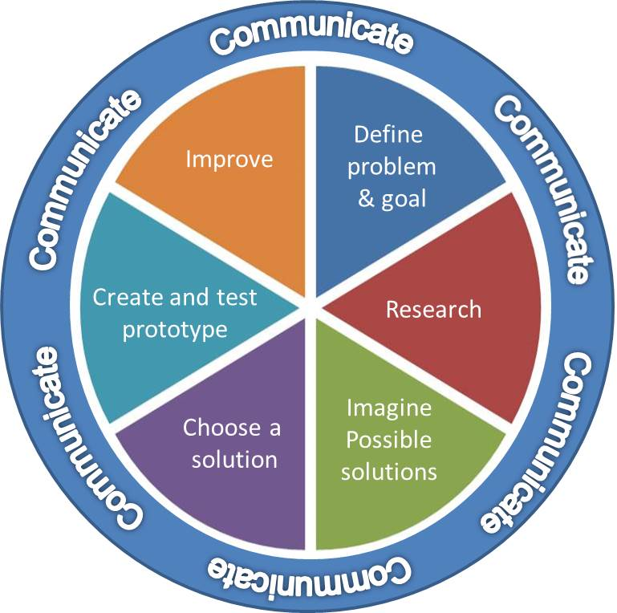
Engineering Design Process
A series of steps that engineers use to guide them as they solve problems.
It is cyclical and can begin at any step, or move back and forth between steps. ⁽¹⁾
(1) www.ecybermission.com

Slide 3
Engineer
A person trained and skilled in the design, construction, and use of a system or machine.
Needs to be well versed in language arts, as well as math and science
Engineering Fields
Mechanical | Aerospace
Electrical | Nuclear
Chemical | Civil
Biomedical | Computer

Slide 4

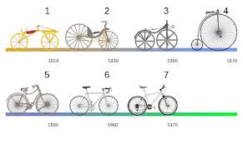
Innovation vs. Invention
Invention
A device or process originated after study and experiment
Innovation
A new improvement to an existing device or process
Invention
Innovations
Image taken from: http://www.novuslight.com/led-market-phasing-in_N239.html
Invention
Innovations
Image taken from: http://lexpower.wordpress.com/2010/07/21/chronological-order-show-me-the-timeline/1000px-bicycle_evolution-en-svg/

Slide 5
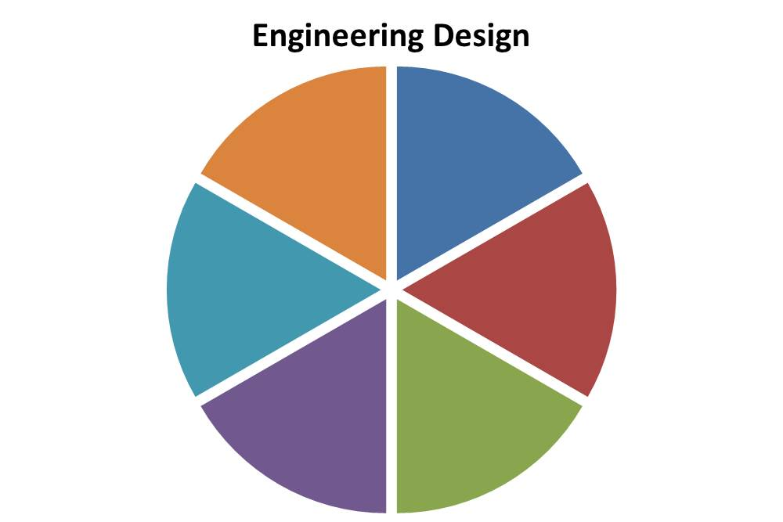

Engineering Design Process
Communicate
Define
problem
& goal
Improve
Communicate
Create and test
prototype
Research
Communicate
Communicate
Imagine
Possible
solutions
Choose a
solution
Communicate

Slide 6
Define problem and goal
Identify and describe the issue and the ultimate objective
Consider:
What do you want to accomplish?
What are the requirements?
Are there any limitations?
Who is the customer?

Slide 7

Research
Gather information and investigate existing technologies related to the problem
Talk to individuals who share this problem and could benefit from possible solutions
Image taken from: http://walrus.wr.usgs.gov/infobank/programs/html/facilities/us.archives.html

Slide 8

Imagine possible solutions
Brainstorm ideas.
Be creative and build upon the ideas of others.
Explore and compare many possible designs within your group.
Be open-minded!
Image taken from:
http://www.vinylrecords.ch/J/JO/John/John_Lennon/imagine-capitol/john-lennon-imagine.html

Slide 9



Choose a solution
What materials and tools are needed?
Consider environmental, cultural, time, and financial issues and constraints.
Select the most feasible idea and assign team tasks.
Best
$$$
Image taken from: http://chelseagetsmarried.blogspot.com/2010/10/eeny-meeny-miny-moe.html
Image taken from: http://andrewmatre.com/how-colors-help-make-websites-successful/

Slide 10
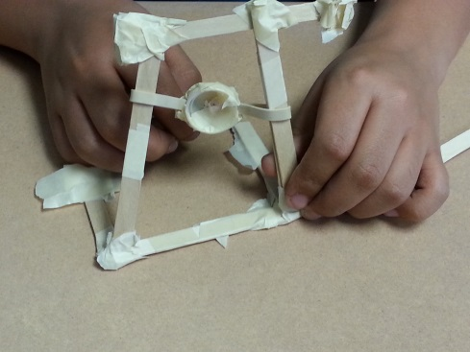
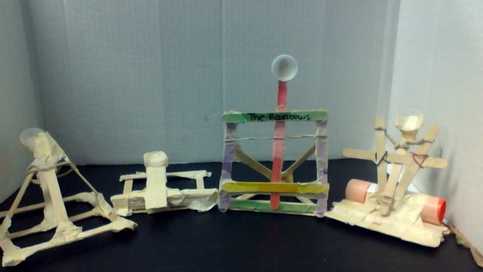
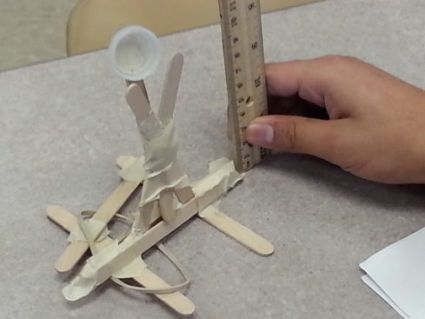
Create & test prototype
Build a protoype
Protoype - an operating version of a solution. It is often made with different materials (cheaper and easier to work with) than the final version. They allow you to test your solution and supply feedback. ⁽²⁾
Push yourself and the group for creativity, imagination, and excellence in design.
⁽²⁾http://www.sciencebuddies.org/engineering-design-process/engineering-design-prototypes.shtml

Slide 11

Improve
Share results and continue to seek how your team could make the solution better.
Iterate your design to make the product the best it can be.
Iterate - to repeat an already completed task to incorporate new information ⁽³⁾
Image taken from:
http://www.rubymarketer.com/improve-search-engine-ranking/
Iterate
⁽³⁾ Ulrich K., Eppinger S. 2000. Product Design and Development. 2nd Edition. Irwin McGraw-Hill, Boston.

Slide 12
Importance of the Engineering Design Process
Provides a methodical approach to help solve problems to achieve objectives within constraints
May be used for any design/build project
Whole robot, robot components, project engineering notebook, and marketing presentation
Helps students maintain some objectivity with respect to design ideas
Helps identify problems early

Slide 13
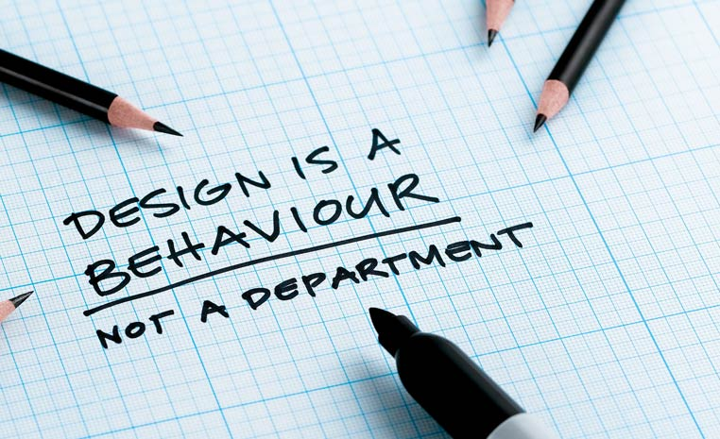
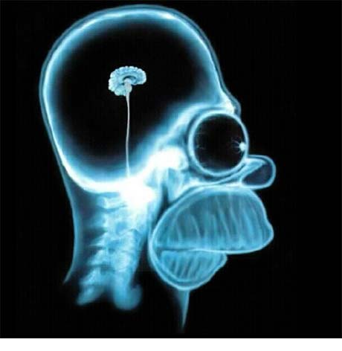




A good product is the result of a good process.
+
+
What is design?
What is the Engineering Design Process?
Examples help
What tools are available?

Slide 14
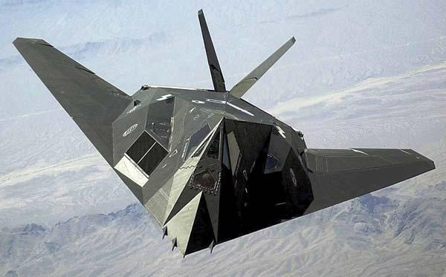

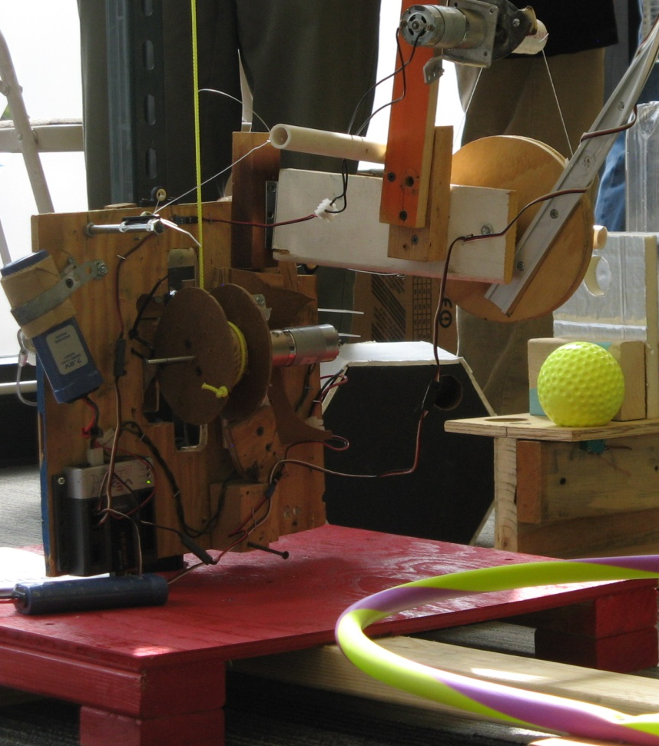
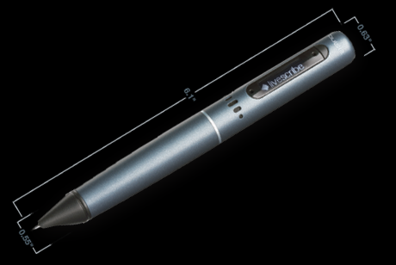
What is Design?
Design is about creating – form and function. It’s achieving objectives within given constraints
Notes:
Design is about using the knowledge that we have and applying that knowledge (usually in conjunction with math and technology) to create something that has not yet existed. Designers spend a lot of time focusing on the form (physical characteristics) and function (what it actually does) of a design. Design projects are focused on achieving specified objectives while working within a host of constraints.

Slide 15
The Engineering Design Process is an set of steps for creation and invention.
ASK
IMAGINE
IMPROVE
The Goal
PLAN
CREATE
Notes:
These words are key to the engineering design process. The process is an ongoing cycle that is centered around a particular goal.

Slide 16
What is the Engineering Design Process Mirrors standard steps in problem-solving.
Problem Definition (Analysis)
Conceptual Design (Synthesis)
Preliminary Design (Evaluation)
Documentation is crucial!
Design Decision (Decision ☺)
Detailed Design (Action)
Production, Integration & Test (Build & Verify)
Notes:
The documentation serves several key purposes:
Formalizes the process
Reinforces what we want them to learn
Helps students maintain some objectivity with respect to design ideas

Slide 17
Use Project Engineering Notebook to manage the process steps
Documentation
create using design process
notebook has fewer requirements and alternatives to consider
start on day 1 as a tool to manage design process
Formalizes the design process
Reinforces process learning
Helps maintain design idea objectivity
Required by every team and due on Practice Day - NO EXCEPTIONS
crucial record of the process
enhances communication between groups
essential to bring new people up to speed
use to continually verify compliance
establish test plan against requirements early in process

Slide 18
Define the problem in detail without implying a particular solution.
Problem Definition
desired attributes and behavior
expressed as “being” statements (not “doing”)
Clarify design objectives
Identify constraints
Establish functions
Establish requirements
restrictions or limitations on a behavior, a value, or some other aspect of performance
stated as clearly defined limits
often result of standards & guideline
Attributes List: Objectives, Constraints, Functions, and Requirements list
actions the design must perform
expressed as “doing” statements
typically involve output based on input
non-negotiable objectives and/or functions
Documentation

Slide 19
Objectives, constraints, functions & requirements may be broad-based.
Some items are absolute – others negotiable
Functionality (inputs, outputs, operating modes)
Physical (size, weight, temperature)
Reliability, durability, security
Power (voltage levels, battery life)
Performance (speed, resolution)
Ease of use
Conformance to applicable standards
Compatibility with existing product(s)
Cost

Slide 20
Both functional & non-functional requirements used for a design.
Functional requirements:
support a given load
grasp a given size
reach a given distance
move at given speed
etc.
Non-functional requirements (usually form-focused)
size, weight, color, etc.
power consumption
reliability
durability
etc.

Slide 21
Design involves creativity within boundaries. Consider any viable solution concept.
Conceptual Design
precise descriptions of properties
numerical values corresponding to performance parameters and attributes
Establish design specifications
Generate design alternatives
let the creativity flow
don’t marry the first idea
beware of “we can’t…” and “we have to…”
must live within the design space
Performance Parameters
Revised objectives and constraints
Function List
Brainstorming results
Documentation
Notes:
Design specifications may focus on form or function, but should be quantitative.
The “can’t” and “have to” statements tend to come out of the mouths of students immediately after Kick-Off, as they discuss the design ideas that come quickly to mind. Encourage students to keep their minds open as they put design ideas on the table. It’s very easy for students (and adults) to lock in on one design and forget that there are other (many other) viable solutions.

Slide 22
Nail down enough design details that a decision can be made.
Preliminary Design
scale models – cardboard, straws, paper clips, paper, pencils, white glue, etc.
computer models (CAD)
mathematical models
“Flesh out” leading conceptual designs
Model, analyze, test, and evaluate conceptual designs
proof-of-concept
simulation results
qualitative and/or quantitative
CAD Drawings
Model photos
Simulation and Proof-of-concept information
Documentation

Slide 23
The “optimal” design solution may or may not be obvious.
Design Decision
evaluate design alternatives against specifications
a “better” technical solution may not make the cut due to differences between design objectives and constraints
Select the optimal design based on the findings from the previous stage
Trade off criteria
Trade off results
Optimal design decision tool and data
Documentation
Notes:
Engineering problems are commonly referred to as optimization problems, because there is always a give and take between design objectives and constraints. In many cases, “better” solutions may not make the cut because they are not optimal.

Slide 24
Time to go from idea to reality.
Detailed Design
document compliance to objectives, constraints, functions, requirements
Refine and optimize choices made in preliminary design
Articulate specific parts and dimensions
Fabricate prototype and move toward production
define sub assembly parts and interfaces
material available to build more than 1 robot
consider test approaches
Design choice details
Parts list with dimensions
Prototype photos
There is a huge gulf between a great idea and a working prototype!
Documentation
Notes:
Students are prone to think that they are almost done once they make the design decision. They do not understand just how much work is required to move from idea to reality. Experience will teach them (hopefully) that they will encounter a number of additional, smaller design decisions along the way from idea to prototype.

Slide 25
Turn your design to reality and verify it works
Production, Integration & Test
ensure safety training is available and safety practices are followed
reuse prototype parts
Build sub-assemblies
Integrate completed sub-assemblies
Test, practice, improve … repeat
may require quick plan development to recover from problems
ensure test approach verifies specifications compliance
may be wise to have part of the game field
Build Directions
Safety training and practices
Test plan and results, and parts of Game field
Documentation

Slide 26
The Engineering Design Process is generally iterative, not linear.
Problem Definition (Analysis)
Conceptual Design (Synthesis)
Preliminary Design (Evaluation)
Detailed Design (Action)
Design Decision (Decision ☺)
Documentation is crucial!
Production, Integration & Test (Build & Verify)

Slide 27
How is the Engineering Design Process applied?
Examples help
Robotics questions examples
What tools are available?
Problem Solving Tool References
Engineering Software Tool References

Slide 28
The design process begins with some initial problem statement.
Problem Definition
Initial Problem Statement
Design a robot to play this year’s game.
Design problems are often ill-structured and open-ended.
Asking questions is a great way to begin defining the problem to be addressed.

Slide 29

Think in terms of questions that would help define the problem and guide the design.
What scoring strategy will we use?
What type of steering is desired?
How many degrees-of-freedom does the robot need?
What maximum reach must the robot have?
How fast does the robot need to be?
How much weight must the robot lift?
What physical obstacles must the robot overcome?
Will the robot be interacting with other robots?
What sight (or other) limitations will be placed on the driver?
What functions must the robot perform?

Slide 30
Begin to categorize questions in terms of what information the answers communicate.
Clarifying objectives
What scoring strategy will be adopted?
How much practice time will drivers have?
Identifying constraints
Can the robot touch other robots?
Can game pieces touch the field?
What are the dimensions of key parts of the field?
Establishing functions
What scoring strategy will be adopted?
How much ground must the robot cover in a round?
Establishing requirements
What minimum size must the robot be to carry a given game piece?
How much weight must be lifted to carry a given game piece?
Problem Definition
Notes:
Students need to learn the art of asking good questions in a variety of venues, particularly as it relates to defining design problems. Encourage them to write out their questions and categorize them. More questions will result in a better-defined problem. In a real-world scenario, there will typically be a client for whom the design is being created. A significant portion of the questions will be directed to the client. It is also beneficial to direct questions to those who will ultimately be using the device.

Slide 31
Think about specific details and various means of achieving certain functions.
Conceptual Design
Establishing design specifications
What is the maximum torque required to pick up a game piece?
What is the maximum reach needed?
What is the smallest space in which the robot will operate?
Generating design alternatives
Could the robot have 2, 3, or 4 wheels? Treads?
Could game pieces be lifted from above or scooped from below?
Could the robot have more than one arm?
Notes:
The answers to all of these questions help define the “design space” – the boundaries within which the design must live. In terms of BEST, it is imperative that students read all of the rules thoroughly. The information contained within the generic and game specific rules are essentially equivalent to the information that a client could provide…actually, it’s probably a lot more detailed than what a client would provide.

Slide 32
What tools* are available to aid in the Engineering Design Process?
Problem Definition
Questions – previous examples
Attributes List – objectives, constraints, functions, requirements
Pairwise Comparison Chart
Objectives/Constraints Tree
Conceptual Design
Questions – previous examples
Brainstorming
6-3-5 Method
Preliminary Design
Function-Means Tree

Slide 33
What software tools are available For Eng. Drawing?
Company | Product | Company Web Site Description
Intelitech | easyC® v4 for Cortex | Robotic programming - easyC’s simple to use graphical interface does all of the syntax and spacing, allowing focus on program flow and design
Robot C | Robot C for Cortex & PIC | Robotics programming - C-based programming language with a Windows environment for writing and debugging programs
Company | Product | Company Web Site Description
MathWorks | Simulink (access to MATLAB) | Graphical editor, customizable block libraries, and solvers for modeling and simulating dynamic system. Build the model, simulate the model, analyze results, manage projects, and connect to hardware.
Wolfram | Mathmatica | Computational Tool - applies intelligent automation in every part of the system, from algorithm selection to plot layout and user interface design, reliable, high-quality results without needing algorithm expertise

Slide 34
What software tools are available For Eng. Drawing?
Company | Product | Company Web Site Description
Dassault Systèmes | SolidWorks | 3D mechanical CAD, design validation, and data management - Intuitive 3D design puts your focus on innovation, accelerates your design process, higher process efficiency, improved collaboration
HSM Works | HSM Works | Integrated CAM for SolidWorks - Create high-quality toolpaths within minutes, comprehensive 2D and 3D CAD capabilities of SolidWorks mechanical design solutions and quickly extend any knowledge gained to the CAM process
Inspirtech | Computer based training | SolidWorks Training & Tutorials - structured training solution, with examples and exercises, structured in such a way that each topic can be either thoroughly examined or quickly understood, based on the student’s aptitude
Available Software Tools

Slide 35
In summary:
Engineering Design Process
Provides a methodical approach to help solve problems to achieve objectives within constraints
May be used for any design/build project
Whole robot, robot components, project engineering notebook, and marketing presentation
Helps students maintain some objectivity with respect to design ideas
Helps identify design problems early

Slide 36

Are there any questions?

Slide 37
THANK YOU

